Slide 1
Microsoft MakeCode
[ Name ]
Hands-on Computing Education
[ Title ]
Notes:
Introductions
Speaker
Topic

Slide 2

Augmented Reality Journey Builder Collaborate with engineers and technical artists to create an augmented sensory virtual reality experience for customers. Gamers, artists, and actors with a passion for storytelling with technology can find a future in this role.
Jobs of 2030
AI Healthcare Technician Examine and prescribe appropriate treatment to patients, aided by Artificial Intelligence driven diagnosis software, digital examination tools and remotely accessible doctors. This role could be filled by any healthcare professional who is comfortable with digital equipment and AI healthcare algorithms.
Transport Controller Monitor, plan and regulate air and road space traffic using AI systems for autonomous cars and drones. The ideal candidate should be comfortable confronting occasional high-stress environments, and competent using sophisticated AI transport operations tools.
Smart City Analyst Ensure the steady and secure flow of data around the city – including biometric, environmental conditions, citizen and asset data. This individual will analyze system data for anomalies, troubleshoot embedded systems and sensors for issues, diagnose faults and replace IoT device components and circuitry.
“Education is the passport to the future,
for tomorrow belongs to those who prepare for it today." - Malcolm X
Notes:
First, let me start by setting some context for why teaching and learning computing skills is so important
I think we call all agree that the purpose of K12 Education is to prepare students for college, career and citizenship
I love this quote from Malcolm X that also embodies this belief that: “Education is the passport to the future. Tomorrow belongs to those who prepare for it today”
[Click]
We live in a time of unprecedented technological change, with a rapidly evolving economy and labor market
These are some of the job listings that analysts and futurists have predicted for the year 2030:
Augmented Reality Journey Builder – designing virtual experiences
AI Healthcare Technician – using artificial intelligence to diagnose and treat patients
Smart City Analyst – analyzing data from IoT sensors placed around urban areas
Transport Controller – for automated vehicles and drones
[ Source: https://www.cognizant.com/whitepapers/21-jobs-of-the-future-a-guide-to-getting-and-staying-employed-over-the-next-10-years-codex3049.pdf ]
All of these jobs require a deep level of comfort and understanding of technology
These are not Computer Science jobs, these are normal everyday jobs
And this reality is only 10 years away – today’s 5th grader will be applying for jobs like this
So, when Microsoft thinks about Education, we think about how we can best help Schools and Educators prepare students for this future – not just by using technology to teach and learn, but by teaching and learning about technology
Our mission is to empower every student to be confident inventing and creating things with technology

Slide 3
31% Growth
Projected in Software Development between 2016 - 2026
10%
3%
18%
10%
3% of US Bachelor Degrees are Computer Science
20% of US Computer Science degrees are non-white
18% of US Computer Science degrees are female
Notes:
But a lot of students are being left behind, and are not being prepared for this future world
The number of computer science graduates is a leading indicator for K-12 computing education
There is huge growth and demand for technology skills in the economy – software development has been growing at 31% in the US (source: US Dept of Labor), 4 times faster than any other sector
But there’s not enough skilled students, nor an equitable pipeline of talent
Technology creators are going to be shaping our future – and we need to make sure those creators represent all of us
Only 3% of all undergraduate degrees awarded in the US are in Computer Science related fields
And of that 3%, only 18% of those are women
And only 20% are non-white or Asian
So, not only is there a big Labor Market shortage, but there is a huge Equity issue at stake here as well
And that’s why Microsoft is investing in tools like MakeCode to make learning Computer Science fun and exciting for a diverse student population.

Slide 4

Computer Science
Notes:
And we know this problem starts in K12 Education
Computer Science or any of the CTE classes have had some challenges
The first challenge is simply educator capacity – there’s simply not enough teachers with the right technical skills to teach these subjects
The second challenge is equitable access and engagement – usually computer science or other technology classes are offered as an elective, and we’ve seen that girls and other minority student populations tend to opt out of these classes
So, our challenge is to make learning about technology relevant, fun, and exciting for every student, and to integrate more computing education into the core curriculum
That’s why we’re trying to shift computing education from the basement computer labs into more of the core curriculum, and the Maker Spaces in schools

Slide 5
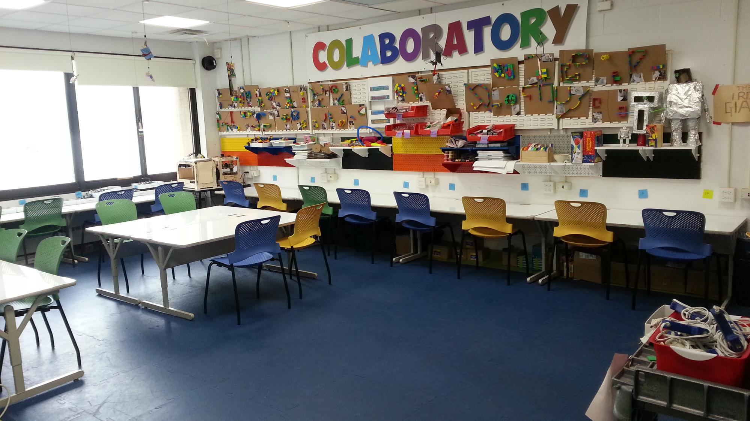
Hands-on Computing
Constructing Knowledge
Design Thinking
Trial & Error
Collaboration
Project Based
Inclusion & Equity
Creativity & Personalization
Student-led inquiry
Learning by Doing
http://makered.org/wp-content/uploads/2013/03/colab-room.jpg
Notes:
These types of spaces are warm, welcoming, and give students the freedom to be creative, to build and construct things with technology
This type of learning space supports what we call Hands-on Computing
Where the learner is at the center of the learning activity, not the technology
Technology is not an endpoint, it’s a classroom material with which students can experiment and learn with – like paper or popsicle sticks – only infinitely more powerful
We would like to liberate technology classes from the basement computer labs and integrate computing education into the core curriculum and classrooms
Our approach to computer science is hands-on, it’s playful, it’s personal
And it’s something we believe every student should be exposed to

Slide 6

Physical Computing
Holistic View of Computing Education: HW + SW
Creativity & Self-Expression
Learning by Doing
Engages whole Learner:
Mind + Body
IoT Industry Trend
Digital + Physical = Magic
Physical Computing refers to interactive physical systems or devices that can be programmed through software.
Notes:
One of the approaches we take is to focus on Physical Computing
Physical Computing essentially means any kind of physical device that can be programmed
There are several benefits to this approach:
Holistic View of CS education – Computer Science is not just about learning to code. Computer systems are made up of hardware, software, data, networking… and it’s important to teach all aspects.
Creativity & Self Expression – physical computing encourages creativity and personalization when you bring in the crafting and making aspects, and makes it much more engaging for a broad range of students. Coding isn’t done for coding sake, it’s done in service of creating a personally meaningful project for the student.
Learning by Doing – there are no ‘right’ answers, and there is no 1 process to follow to get to a solution, students will try something, fail, and then try something different – that’s the process of learning
Engages the whole learner – there is more and more research to back up the value of kinesthetic and experiential learning beyond early learning programs. Students learn with their hands and their bodies just as much as they do through sitting at a desk and reading or writing.
Industry IoT Trends – the Internet of Things is here, and students are learning skills that will prepare them for a world of intelligent edge devices, and get an understanding of how embedded systems work
Lastly, there is a magical moment that happens when a student makes a light flash, or a buzzer sound through code. The combination of the digital and the physical world showcases the true magic of technology.

Slide 7
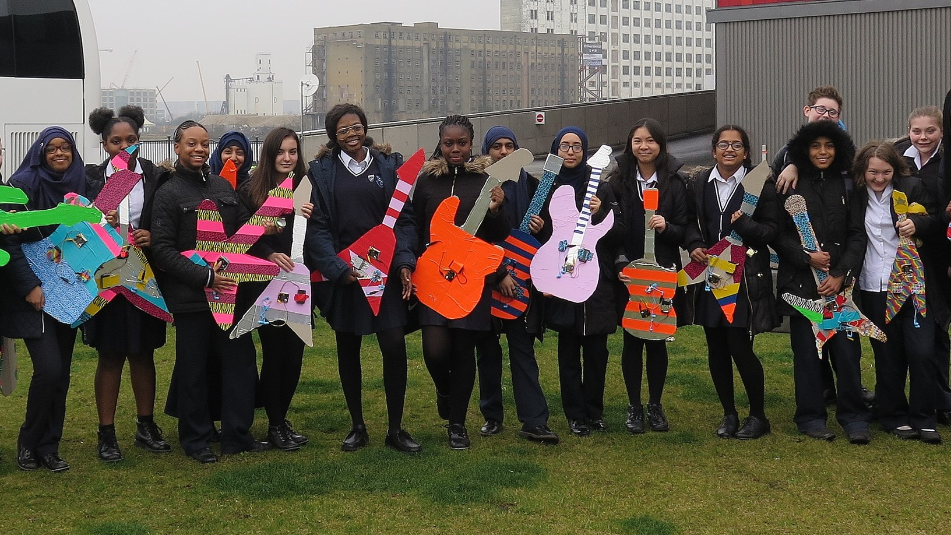
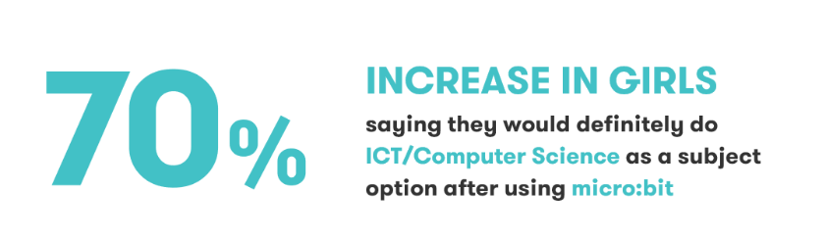
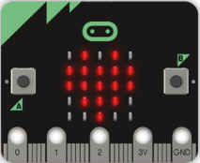
Notes:
And we are starting to see evidence that this approach is working
In the UK in 2016, the BBC distributed a million micro:bits to Year 7 students across the nation
The following year, they conducted a national study among students who had been using the micro:bit, and found a 70% increase in interest among girls to continue with Computer Science (https://microbit.org/research)
There is also a good research whitepaper on the benefits of Physical Computing in Computer Science Education: https://aka.ms/physicalcomp

Slide 8
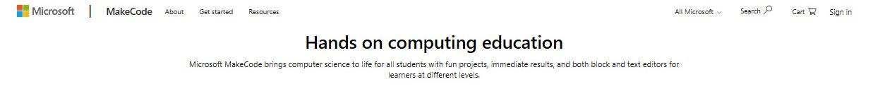
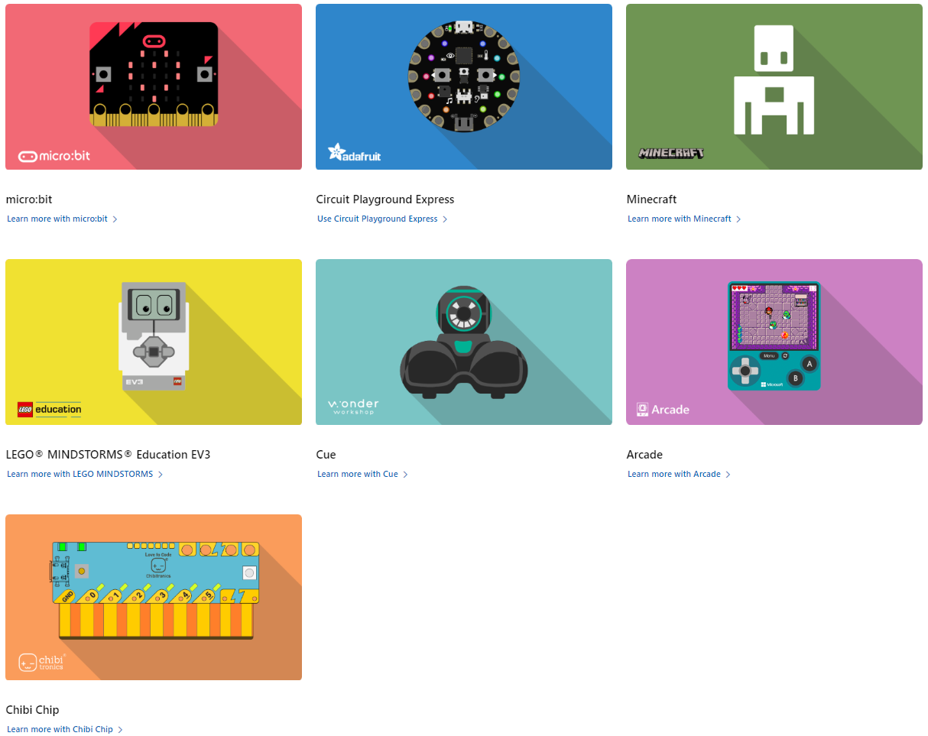
MakeCode.com
Notes:
Microsoft MakeCode is a new approach to computing education that combines the magic of making with the power of code, in a way that engages students of all backgrounds in computational thinking through fun, relevant projects.
Microsoft MakeCode is a free, open source, learn-to-code platform for physical computing devices and Minecraft with both drag-and-drop blocks and JavaScript text coding editors
MakeCode currently supports 7 products including the micro:bit and Minecraft
You can learn more at MakeCode.com

Slide 9
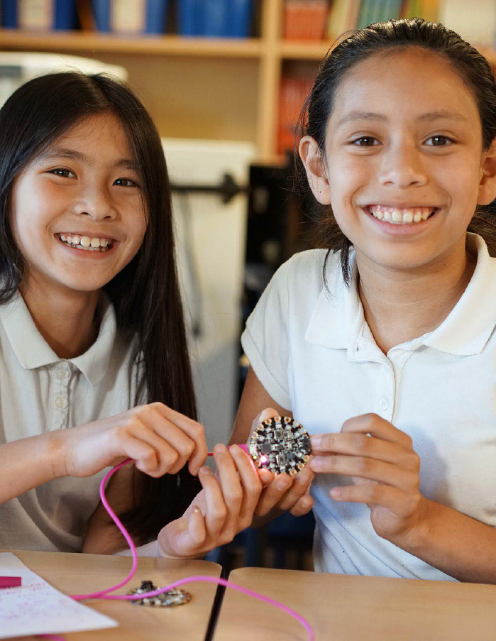
Microsoft MakeCode Hands-on Computing for every student
Just works always, everywhere
Physical and Immersive experiences as a more inclusive approach to computing education
Progression path to real-world skills
Extensible platform for partners
Notes:
MakeCode’s core product tenants are:
Just works always, everywhere – MakeCode “just works” for every teacher in every classroom. Nothing to download and install, cross-platform/device/browser, free, and open source.
Physical and Immersive experiences as a more inclusive approach to computing education – MakeCode curriculum and projects are designed to be fun and engaging for girls and other under-represented student populations
Progression path to real-world skills – MakeCode offers a progression path from drag-and-drop block-based programming to real-world JavaScript and Python text-based programming with a fully featured IDE and the ability for students to switch back and forth between blocks and text coding.
Extensible platform for partners – MakeCode is an open source platform that provides a best-in-class learn-to-code framework for a variety of partners like LEGO and the micro:bit, and includes an extensibility model for custom blocks and accessories.

Slide 10
Demo

Slide 11
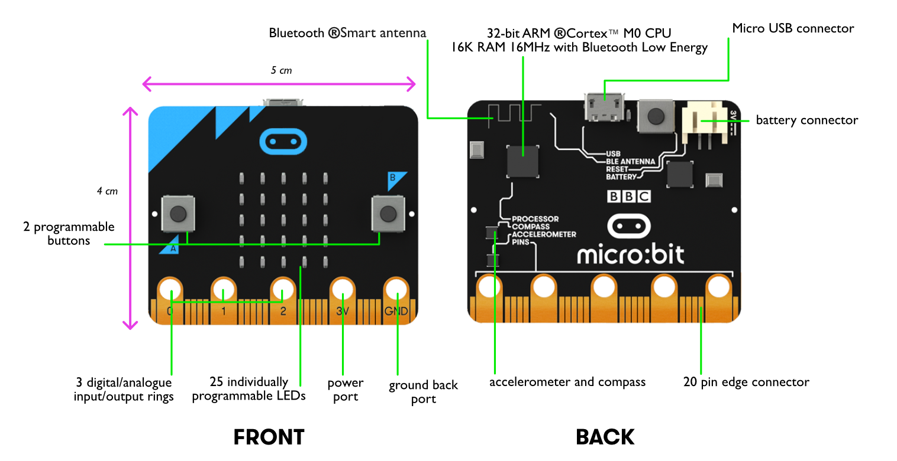

http://microbit.org/hardware/

Slide 12

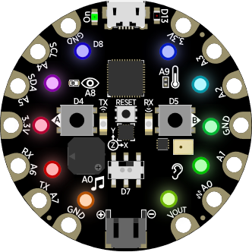
Express
ARM Cortex M0 Microcontroller (32K RAM, 256K Flash )
USB Port
A and B buttons
Infrared receiver, transmitter
Temperature sensor
Light sensor
Motion sensor
Reset button
Microphone
Speaker
14 connector pins
Slide switch
Battery connection
10 neopixel lights

Slide 13

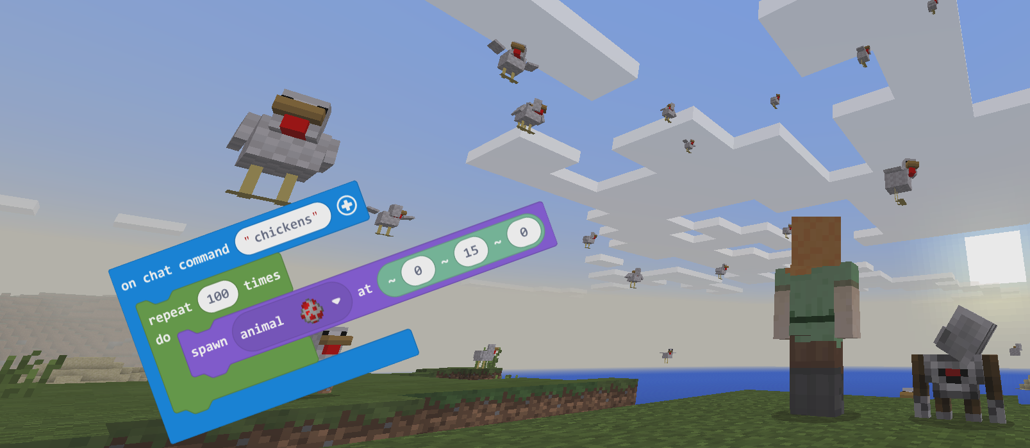
MakeCode for

Slide 14
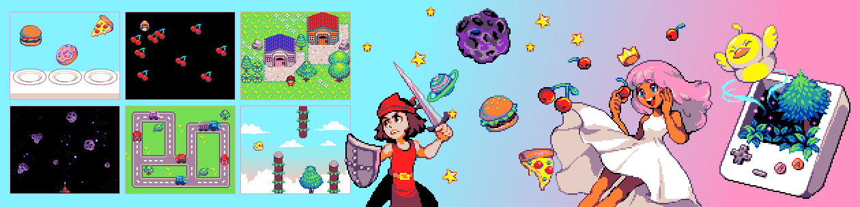
MakeCode Arcade
1980’s Retro Arcade Game Development Platform
Friction-free (no hardware/software required)
arcade.makecode.com

Slide 15

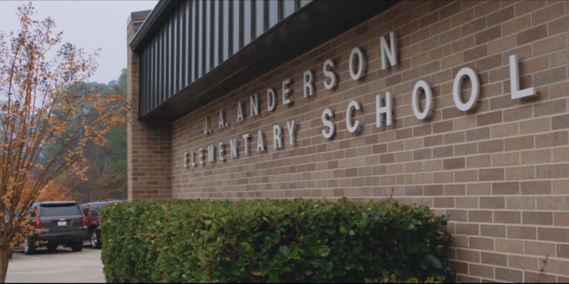
Schools using MakeCode
Wimbledon School – https://youtu.be/cHE9rarrBoo
Lufkin ISD – https://youtu.be/rcpAA59Pppo
Notes:
Play videos
Other examples of case studies:
https://microbit.org/impact/case-studies
https://education.minecraft.net/how-it-works/why-minecraft#learn-to-code-in-Minecraft

Slide 16
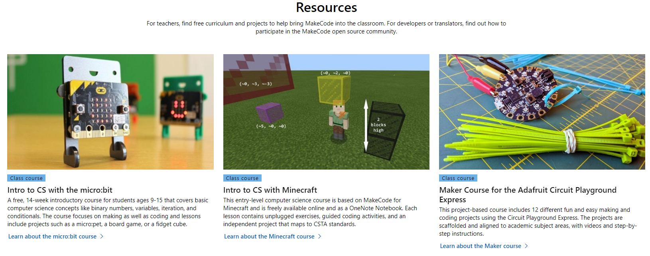
Resources
https://www.microsoft.com/en-us/makecode/resources

Slide 17
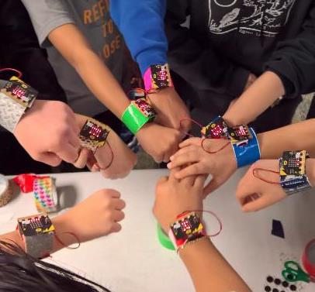
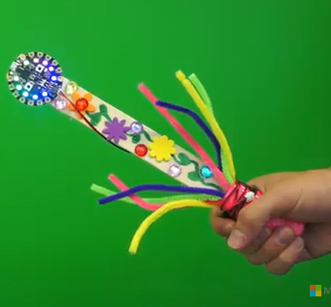
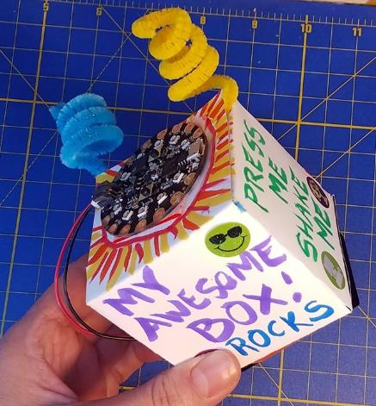
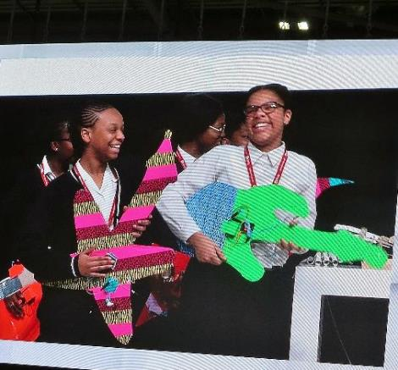
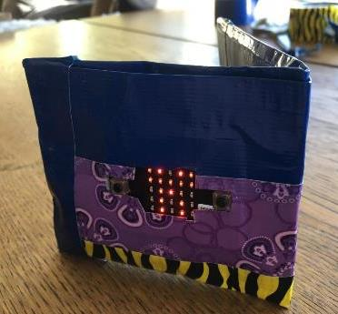
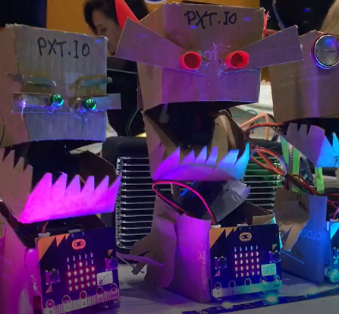
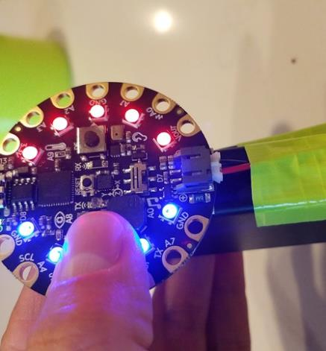
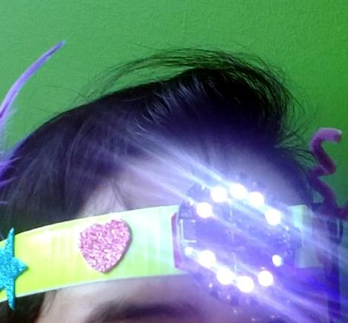
Example student projects
WRIST CUFFS
MAGIC WAND
FIDGET CUBE
AIR GUITARS
WALLET/PURSE
LIGHT MONSTERS
LASER TAG
HEADLAMP

Slide 18
Thank You!

Slide 19
Appendix

Slide 20
Product | Resources
Micro:bit | Tutorials and Projects – https://makecode.microbit.org Curriculum – https://makecode.microbit.org/courses Reference documentation – https://makecode.microbit.org/reference Hardware Quick Start guide – https://microbit.org/guide/quick Hardware Features – https://microbit.org/guide/features How to Buy – https://microbit.org/resellers
Circuit Playground Express | Tutorials and Projects – https://makecode.adafruit.com Curriculum – https://makecode.adafruit.com/courses/maker Reference documentation – https://makecode.adafruit.com/reference Hardware – https://learn.adafruit.com/adafruit-circuit-playground-express Adafruit projects – https://learn.adafruit.com/adafruit-circuit-playground-express Buy – https://www.adafruit.com/category/937
Minecraft | Tutorials and Samples – https://minecraft.makecode.com Curriculum – https://minecraft.makecode.com/courses/csintro, https://education.minecraft.net/class-resources/computer-science-subject-kit/ Reference documentation – https://minecraft.makecode.com/reference Lessons – https://minecraft.makecode.com/lessons, https://education.minecraft.net/class-resources/computer-science-subject-kit
LEGO | Tutorials and Projects – https://makecode.mindstorms.com Reference documentation – https://makecode.mindstorms.com/reference Buy – https://education.lego.com/shop/mindstorms-ev3
Cue | Download free app (includes tutorials and samples) – https://www.makewonder.com/robots/cue/explore Curriculum – https://education.makewonder.com/curriculum/appliedrobotics Buy – https://store.makewonder.com/collections/products-accessories/products/cue , https://store.makewonder.com/pages/education
Arcade | Tutorials and Samples – https://arcade.makecode.com/ Curriculum – https://arcade.makecode.com/courses Game devices – https://arcade.makecode.com/hardware
Chibitronics | Tutorials and Projects – https://makecode.chibitronics.com Love to Code book – https://get.chibitronics.com/lovetocode-vol1-makecode.pdf Buy – https://chibitronics.com/lovetocode

Slide 21
Why Making?
deepest levels of learning
Bloom’s Taxonomy of Learning
Learning Activity Formats
Student can create a new product or point of view
Applying
Understanding
Remembering
Analyzing
Evaluating
Creating
Do / Construct (Kinesthetic/Experiential)
Student can make judgments and justify decisions
Teach / Present
Talk / Discuss (Social)
Student can distinguish parts, relationship, and how they fit into the whole
Write / Draw
Student can apply information in a different context
Hear (Auditory)
Student can demonstrate meaning from information
Read
Student can recognize and recall information
Watch / See (Visual)
https://en.wikipedia.org/wiki/Bloom%27s_taxonomy
Notes:
Our approach to combining physical Making and Construction with Computer Science and Coding is rooted in Pedagogy
Let’s go back to basics – I’m sure many of you are familiar with Bloom’s Taxonomy of Learning
This is a very widely-accepted framework that was originally created in the 50’s that essentially maps out different levels of student learning
Starting at the most basic level with Recall – can a student show evidence that yes, they remember World War II ended in 1945 on a test
And progressing into deeper levels of learning with Analysis and Evaluation – can a student truly understand complex concepts and apply them in new and different ways? Can they form their own judgement based on their personal experiences and how they internalize knowledge?
And at the very top, can they Create something new and unique
[Click]
Then we can also layer on the different Formats or Modes for learning activities that go on inside a classroom, and see how they map to the different levels of learning
[Click]
And you can see that the deepest levels of learning happen when students are constructing, creating, and getting hands-on with learning materials
I think for too long, we’ve thought about Kinesthetic/Experiential learning activities as only for Early Learning or Montessori classrooms
But that is not the case – it is not the case that when a child enters Primary School, suddenly their mind and body separate, and reading and writing become the only pathways to the brain.

Slide 22
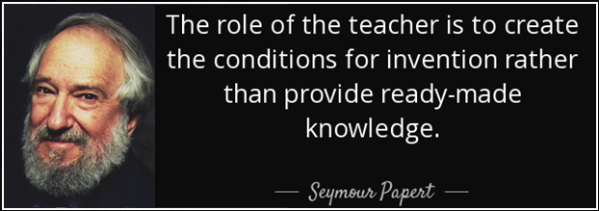
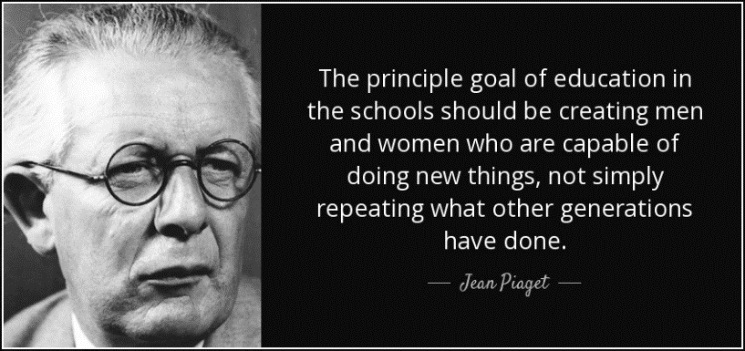
Constructionism learning theory
Constructionism | Instructionism
Learning is the construction of knowledge
Learning is the transmission of knowledge
Learning is intensely personal
All students must have the same baseline knowledge
Project-based
Textbook-based
Student-led
Teacher-led
Purposeful play
Required Curriculum
Evidence of the Learning Process
Standardized Assessment of Knowledge
Notes:
There is a definite shift happening in schools around the world
Constructionism is a theory of learning that was made popular by Seymour Papert in his seminal book, Mindstorms
There are several ways it differs from the more traditional, Instruction-based teaching philosophy
Papert believed that learning is the Construction of knowledge within each student’s mind – much like connecting dots or erecting the walls of a house
Compared to the more widely accepted belief that knowledge is transmitted from a teacher to a student
Because knowledge is constructed by the learner, it is inherently extremely personal – reflecting the individual’s own personal experiences, interests, and beliefs.
This is in contrast to the educational values of the industrial-age which posited that every student should have the same knowledge by the time they graduate
Some other differences:
Constructionism is project-based vs. textbook-based
And it is student-led learning, vs. teacher-led teaching
It values Purposeful Play, tinkering and trial-and-error processes vs. following a strict curriculum
And evidence of the learning process based on the teacher knowing his/her students and documenting their growth is more valuable than formalized assessments
Let me be clear, instruction-based learning is not bad – but I do think we’ve relied too much on this form of learning, and I’m happy to see more of the left side of this table coming into schools around the world.

Slide 23

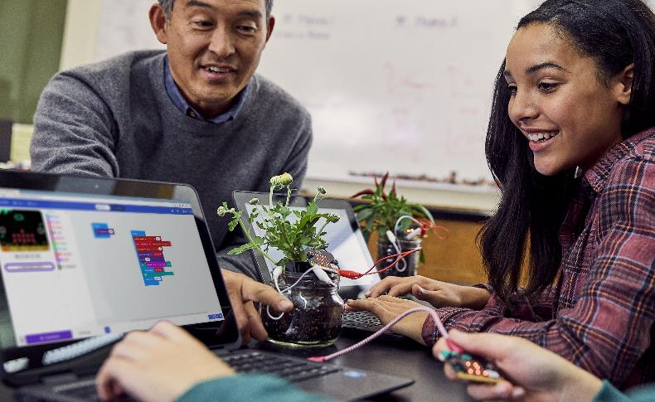
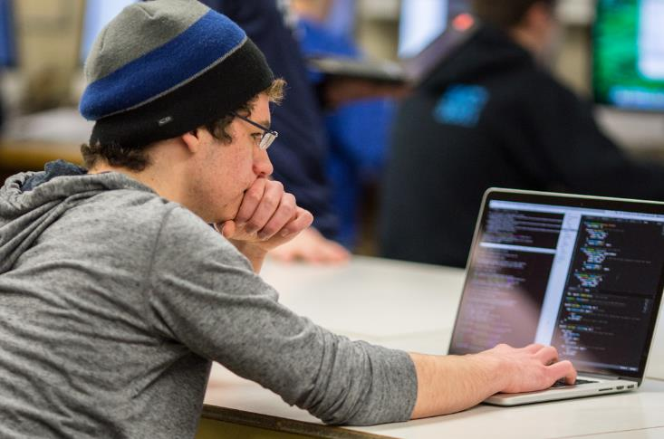





Computing Education products from Microsoft
K – 5
6 – 12
Higher Ed
MakeCode

